Slide 1
Object-Oriented concepts

Slide 2
OOP Concepts
Class
Object
Encapsulation
Abstraction
Inheritance
Polymorphism
  Overloading
  Overriding

Slide 3
Class

Slide 4
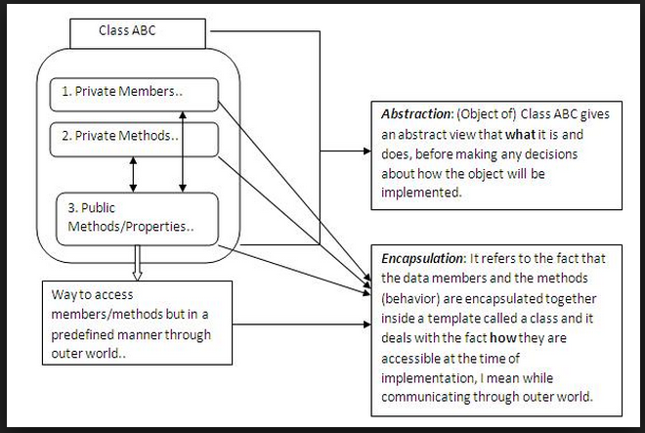
Class
A class is like a template or prototype or blueprint from which objects are created

Slide 5
Example of a class variable
class Person {
String name;
int age;
static int population;
Person (String name) {
this.name = name;
this.age = 0;
population++;
}
Public String getName() {
Return this.name;
}
}

Slide 6
Advice: Restrict access
Always, always strive for a narrow interface
Follow the principle of information hiding:
  the caller should know as little as possible about how the method does its job
  the method should know little or nothing about where or why it is being called
Make as much as possible private

Slide 7
Advice: Use setters and getters
class Employee extends Person {
private double salary;
public void setSalary (double newSalary) {
salary = newSalary;
}
public double getSalary () { return salary; }
}
This way the object maintains control
Setters and getters have conventional names

Slide 8
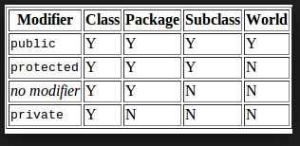
Kinds of access

Slide 9
Object

Slide 10
Concept: An object has behaviors
An Object is instance of Class
An object contains both data and methods that manipulate that data
  An object is active, not passive; it does things
  An object is responsible for its own data
    But: it can expose that data to other objects

Slide 11
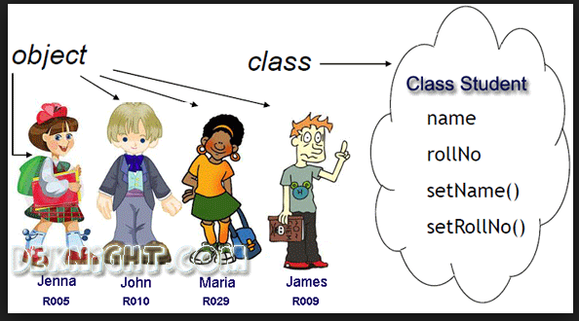

Slide 12
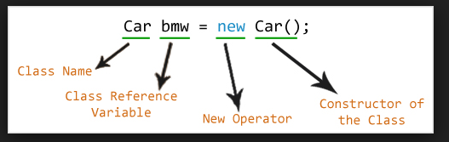
Creating Object

Slide 13
Concept: An object has state
An object contains both data and methods that manipulate that data
  The data represent the state of the object
  Data can also describe the relationships between this object and other objects
Example: A CheckingAccount might have
  A balance (the internal state of the account)
  An owner (some object representing a person)

Slide 14
Concept: Objects must be created
int n; does two things:
  it declares that n is an integer variable
  it allocates space to hold a value for n
Employee secretary; does one thing
  it declares that secretary is type Employee
secretary = new Employee ( ); allocates the space

Slide 15
Notation: How to declare and create objects
Employee secretary; // declares secretary
secretary = new Employee (); // allocates space
Employee secretary = new Employee(); // both
But the secretary is still "blank"
secretary.name = "Ritu"; // dot notation
secretary.birthday ();

Slide 16
Notation: How to reference a field or method
Inside a class, no dots are necessary
  class Person { ... age = age + 1; ...}
Outside a class, you need to say which object you are talking to
  if (john.age < 75) john.birthday ();
If you don't have an object, you cannot use its fields or methods!

Slide 17
Concept: this object
Inside a class, no dots are necessary, because
  you are working on this object
If you wish, you can make it explicit:
  class Person { ... this.age = this.age + 1; ...}
this is like an extra parameter to the method
You usually don't need to use this

Slide 18
Concept: A variable can hold subclass objects
Suppose B is a subclass of A
  A objects can be assigned to A variables
  B objects can be assigned to B variables
  B objects can be assigned to A variables, but
  A objects can not be assigned to B variables
    Every B is also an A but not every A is a B
You can cast: bVariable = (B) aObject;
  In this case, Java does a runtime check

Slide 19
Concept: Constructors make objects
Every class has a constructor to make its objects
Use the keyword new to call a constructor
  secretary = new Employee ( );
You can write your own constructors; but if you don’t,
Java provides a default constructor with no arguments
  It sets all the fields of the new object to zero
  If this is good enough, you don’t need to write your own
The syntax for writing constructors is almost like that for writing methods

Slide 20
Syntax for constructors
Instead of a return type and a name, just use the class name
You can supply arguments
Employee (String theName, double theSalary) {
name = theName;
salary = theSalary;
}

Slide 21
Trick: Use the same name for a parameter as for a field
A parameter overrides a field with the same name
But you can use this.name to refer to the field
Person (String name, int age) {
this.name = name;
this.age = age;
}
This is a very common convention

Slide 22
Internal workings:
Constructor chaining
If an Employee is a Person, and a Person is an Object, then when you say new Employee ()
  The Employee constructor calls the Person constructor
  The Person constructor calls the Object constructor
  The Object constructor creates a new Object
  The Person constructor adds its own stuff to the Object
  The Employee constructor adds its own stuff to the Person

Slide 23
Trick: one constructor calling another
this(...) calls another constructor for this same class
class Something {
Something (int x, int y, int z) {
// do a lot of work here
}
Something ( ) { this (0, 0, 0); }
}
It is poor style to have the same code more than once
If you call this(...), that call must be the first thing in your constructor

Slide 24
Encapsulation

Slide 25
Encapsulation
Refers to the bundling of data with the methods that operate on that data
A Language mechanism for restricting access to some of the object's components
A language construct that facilitates the bundling of data with the methods( or other functions) operating on that data

Slide 26
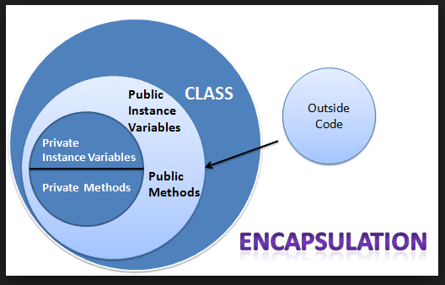

Slide 27
Why Encpasulation?
Used to hide the values or state of a structured data object inside a class
Prevent unauthorized parties' direct access to them
Hiding the complexisity
Achieve loose coupling
Allowing to develop, test, debug, use and modify in isolation

Slide 28
Abstraction

Slide 29
Abstraction
The process of separating ideas from specific instances of those ideas at work.
Hide the actual implementation of an object from the external world that would use the object.
The concept of exposing only the required essential characteristics and behavior with respect to a context

Slide 30
How to achieve?
Interface is a way of providing abstraction.
Iterface are by default abstract and only contains public static final constants or abstract mthods

Slide 31
Why do we need Abstraction
Abstraction make your code readable.
Abstraction makes your code small.
It bocomes much more easier to maintain the code.
Helps to generalize your code.

Slide 32
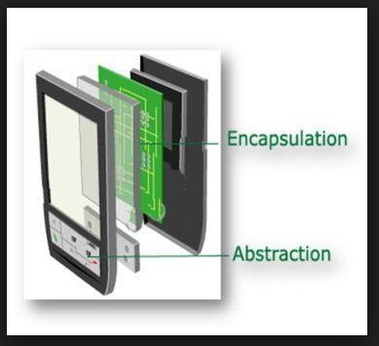
Encapsulation Vs Abstraction

Slide 33
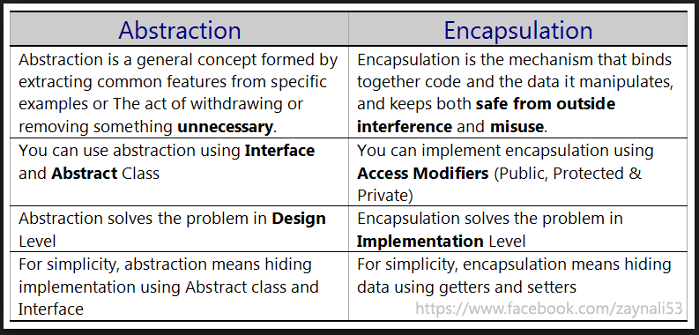
Encapsulation Vs Abstraction

Slide 34
Inheritance

Slide 35
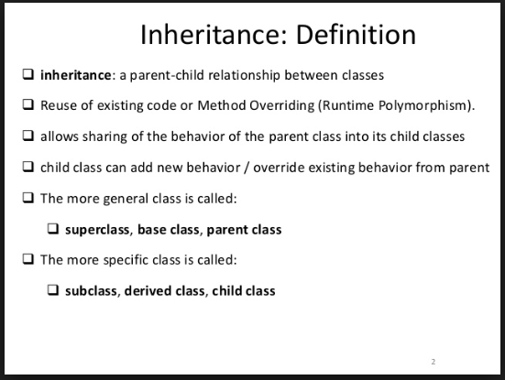

Slide 36
Inheritance(IS-A)
A mechanism that allowed a class to inherit properties of another class.
Inheritance defines is-a relationship between a Super class and its Sub class.
Extends and implements keywords are used to describe in inheritance

Slide 37
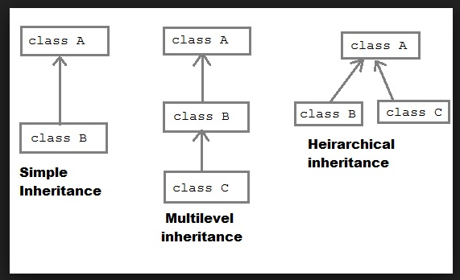
Categories of Inheritance

Slide 38
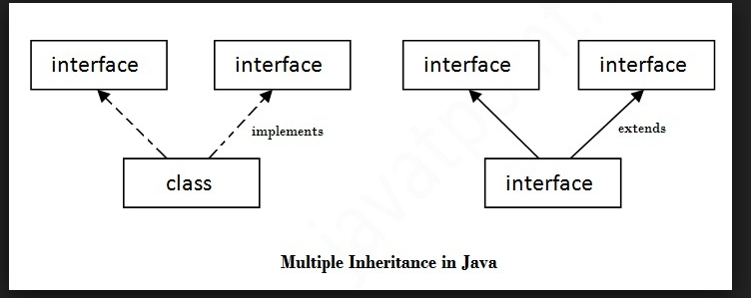
Multiple Inheritance

Slide 39
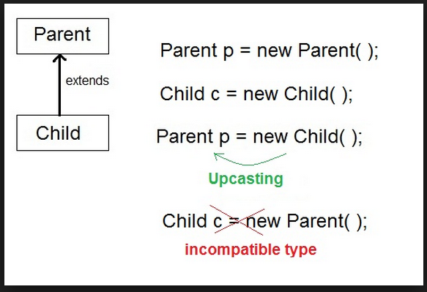
Parent - Child

Slide 40
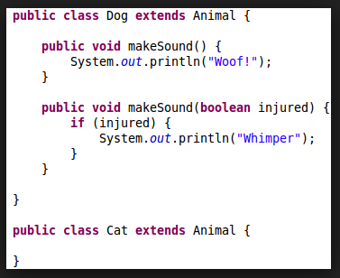
Inheritance Example code

Slide 41
Polymorphism

Slide 42
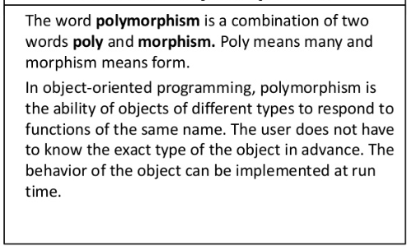

Slide 43
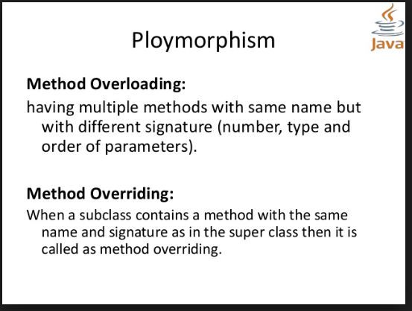
Types of Polymorphism

Slide 44
Static Polymorphism
Achieved through method overloading.
Method overloading means there are several methods present in a class having the same name but different difiniton.

Slide 45
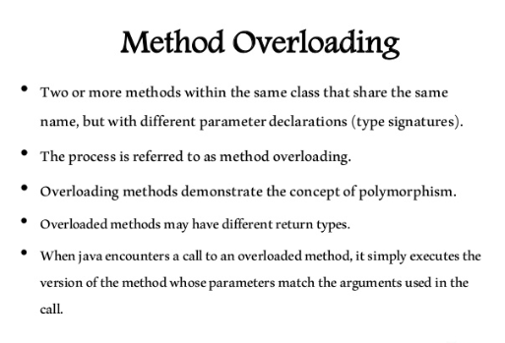

Slide 46
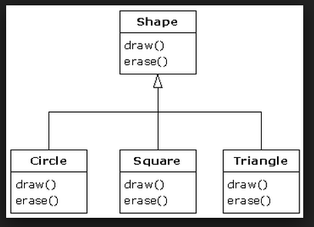
Overloading

Slide 47
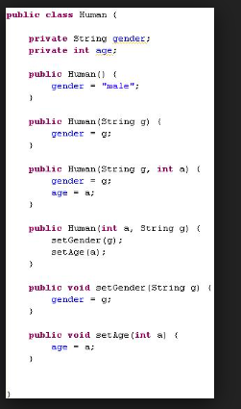
Constructor Overloading

Slide 48
Dynamic Polymorphism
Achieved through method overriding.

Slide 49
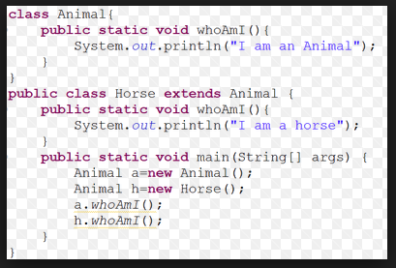
Overriding Example

Slide 50
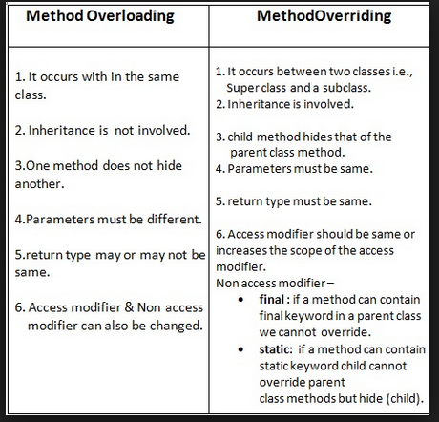
Overloading Vs Overriding

Slide 51
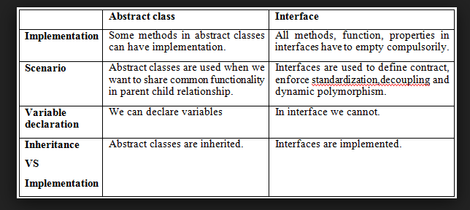
Abstract Class Vs Interface

Slide 52
Practical and Demo
      Demo

